Slide 1
HELLO EVERYONE

Slide 2
ANIMATED STORY OF A HAUNTED HOUSE

Slide 3






Slide 4
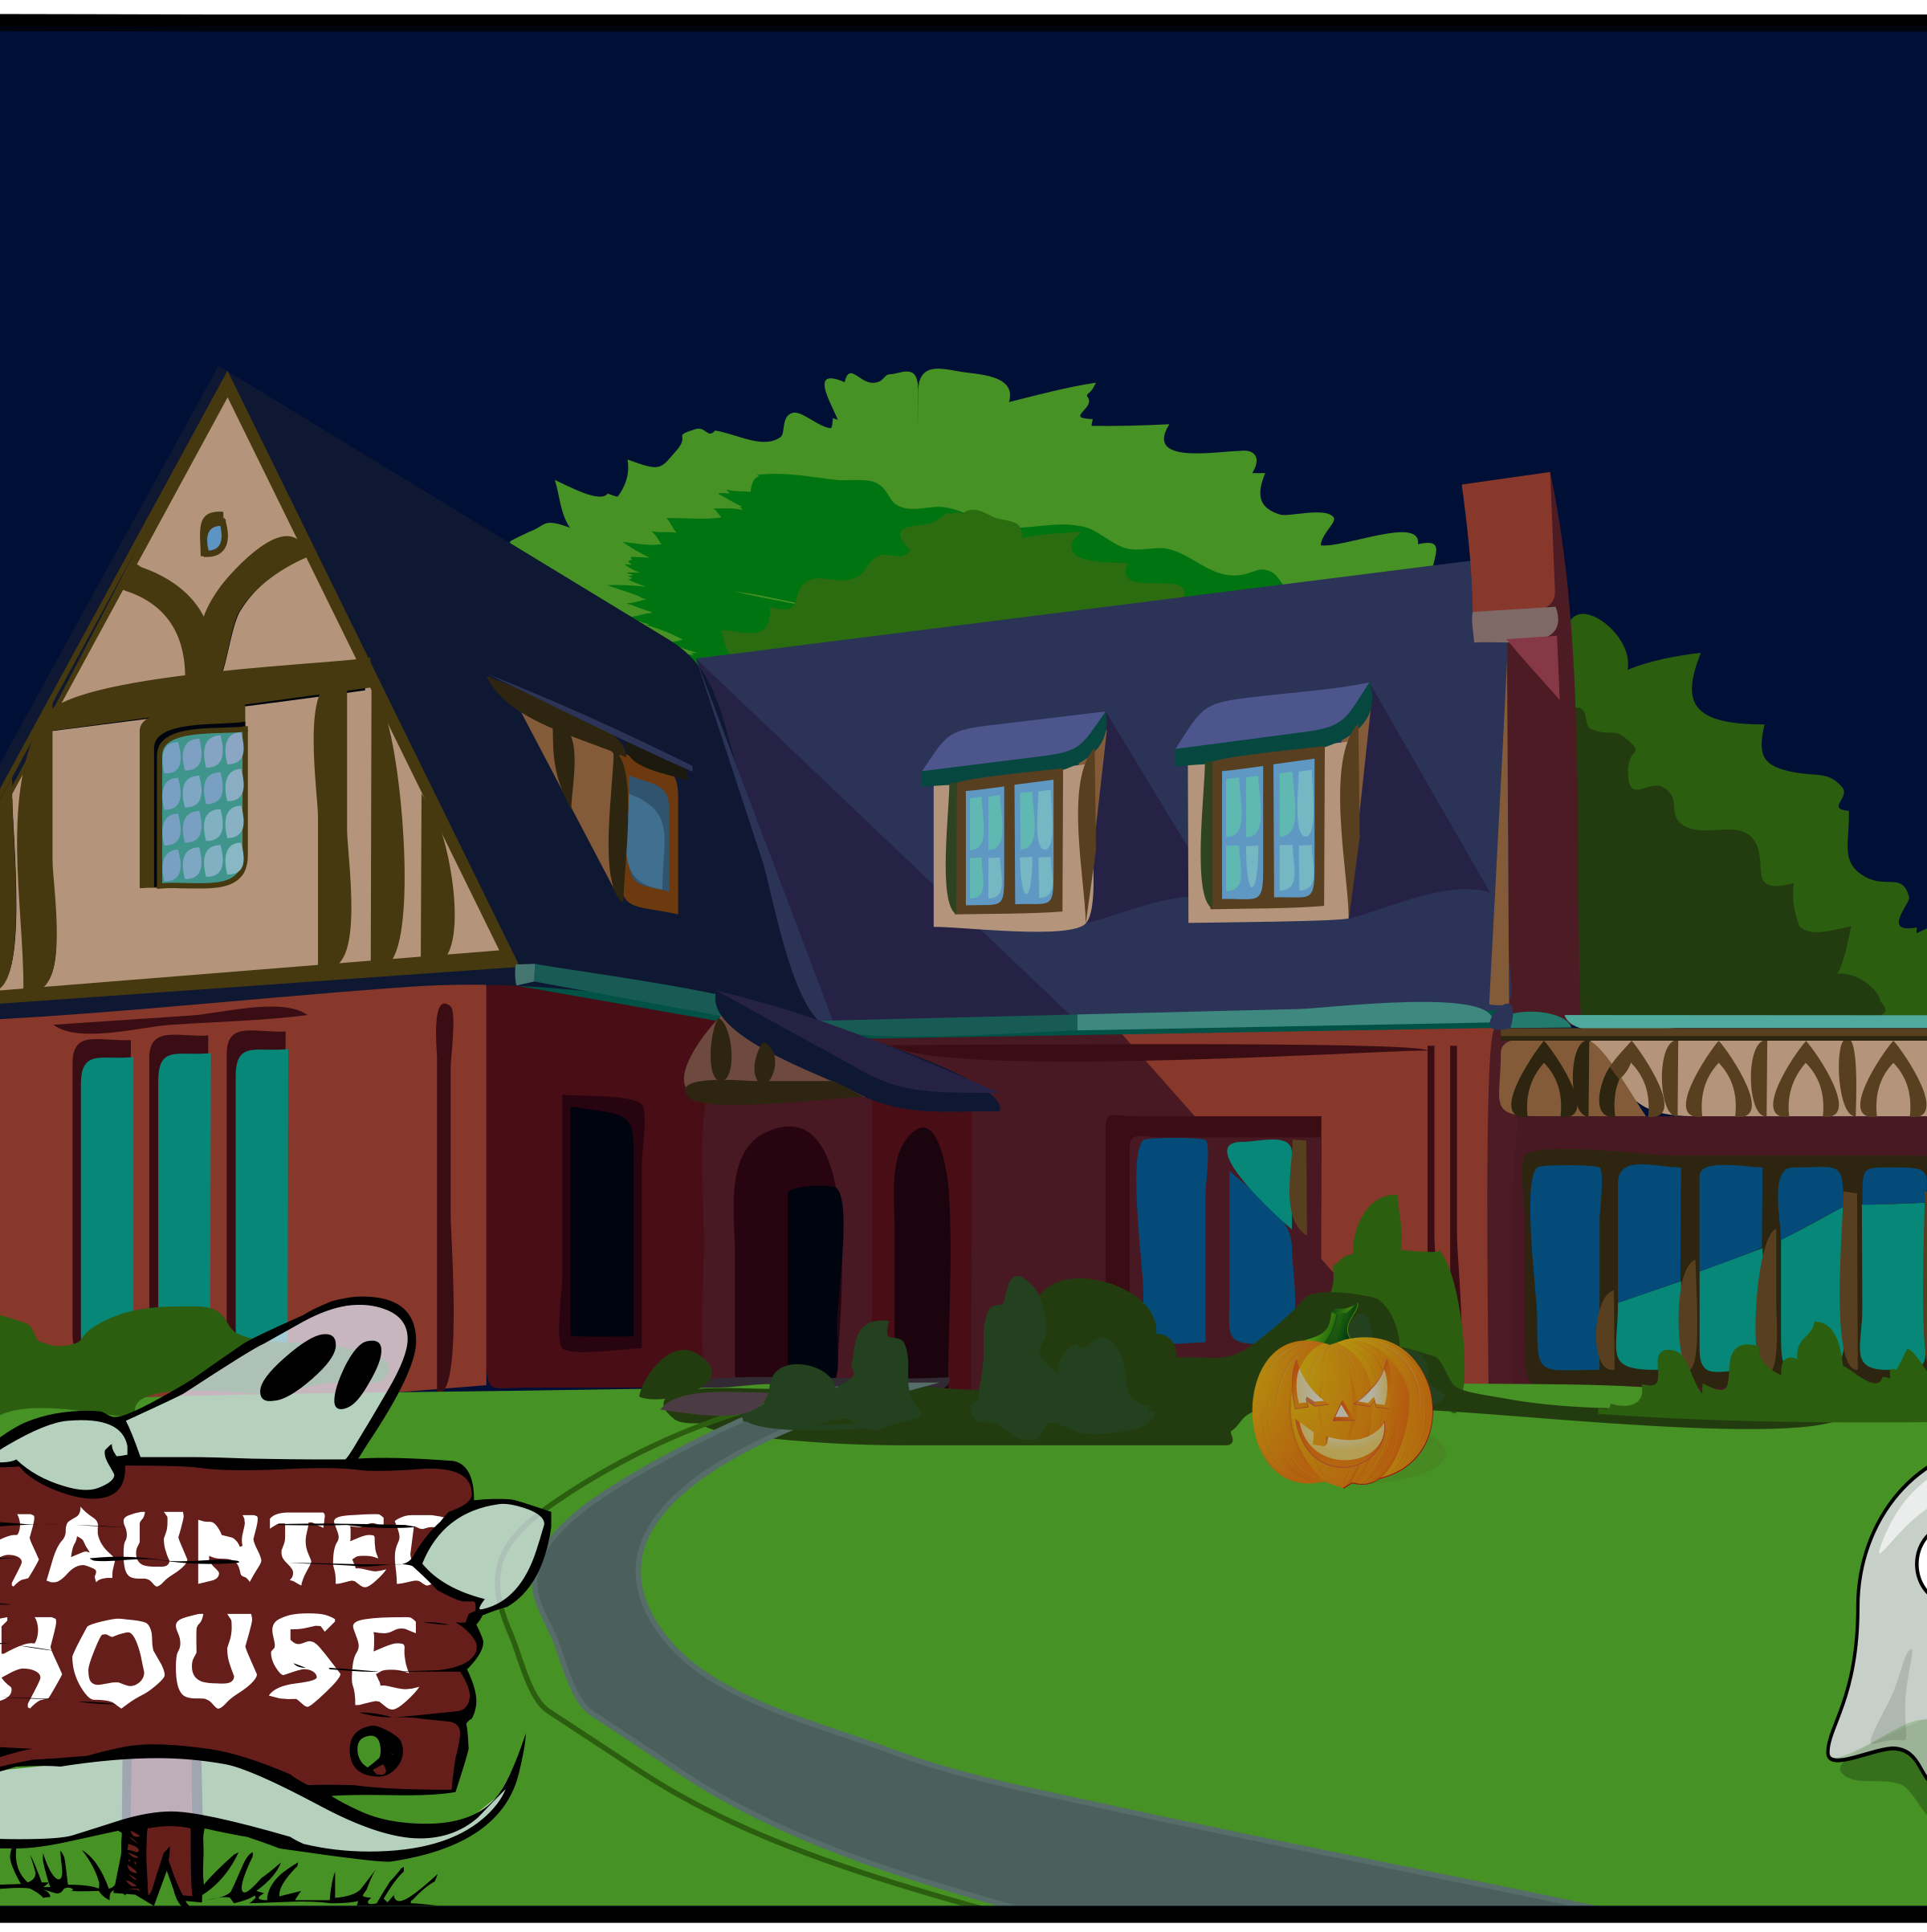


This Photo by Unknown Author is licensed under CC BY-NC

Slide 5
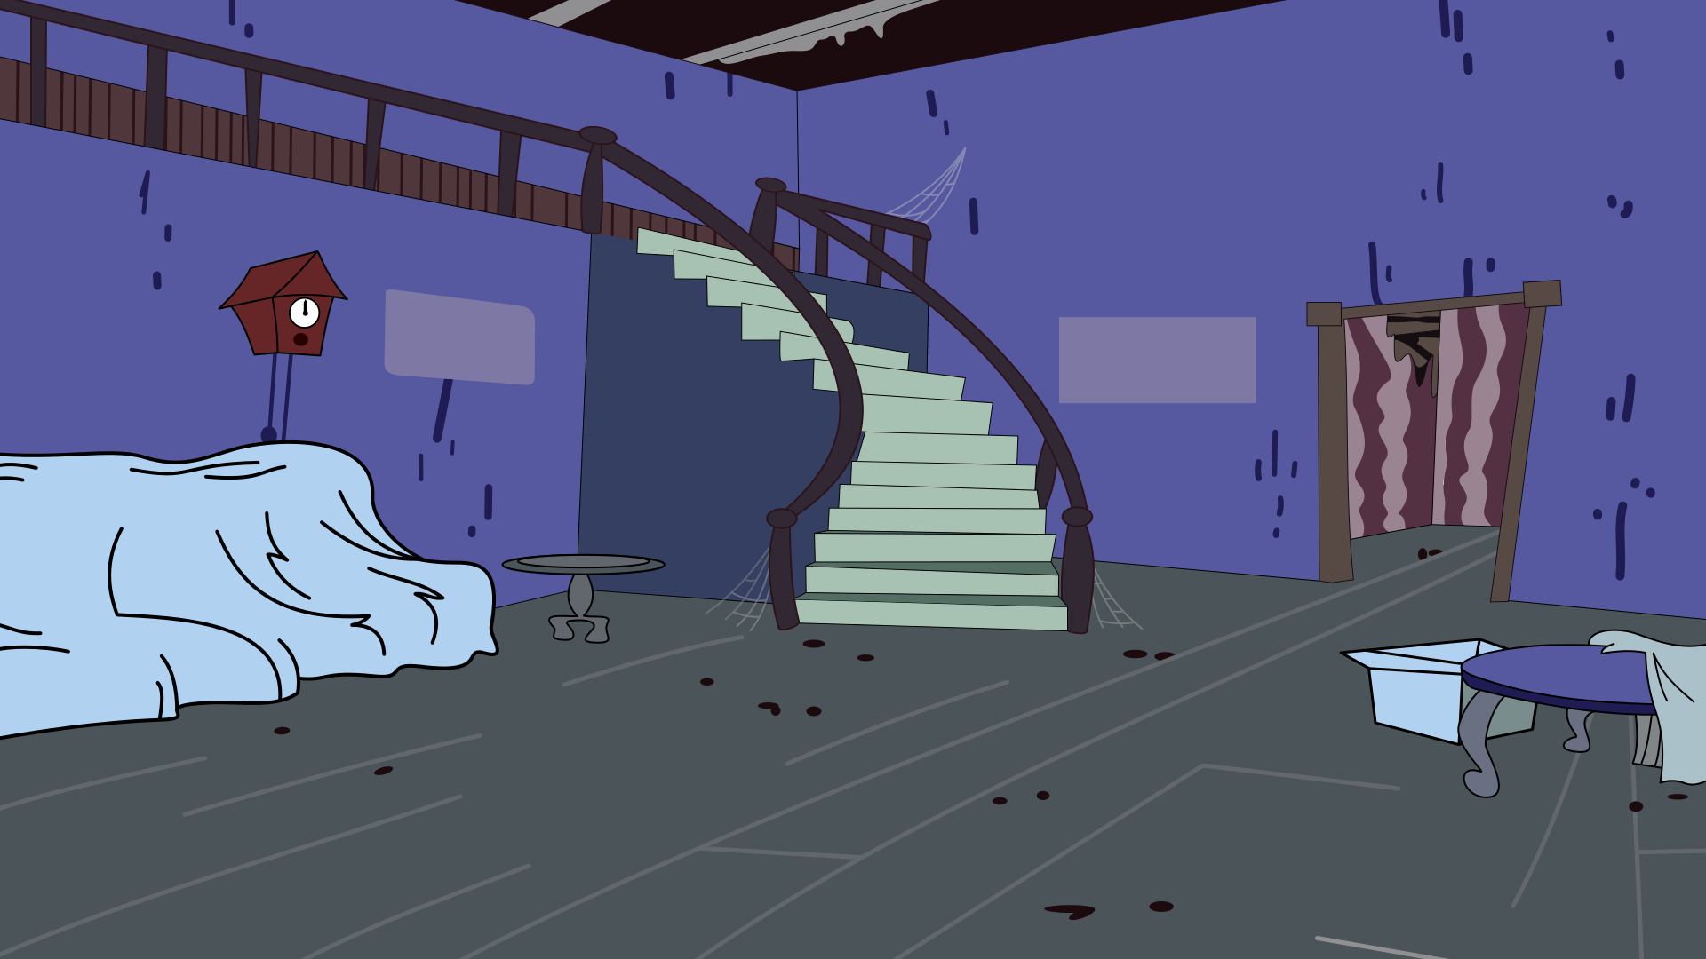


Slide 6
THANK YOU

